Slide 1

Overview Of Programming
You tell the computer what to do in your chosen programming language (Java, C, …)
The computer compiles that human readable code in to processor instructions (ASM, bytecode) that the computer understands
A user can then execute the compiled code to run the program

Slide 2
Java Overview
Java runs in a Java Virtual Machine (JVM) so that Java code can be run on many different operating systems (Windows, Lunix, ...)
Human readable
int i = 1 + 5;
iconst_1
istore_1
iinc 1, 5
JVM bytecode
Machine code
MOV AX, 1
MOV BX, 5
ADD AX, BX

Slide 3
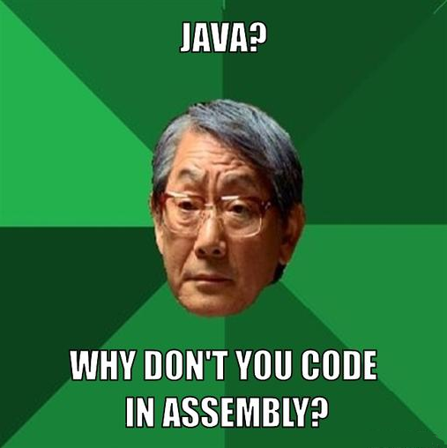
Why Not?
I made an OS once. 1.6K lines to get text, mouse, and keyboard working
No need to reinvent the wheel

Slide 4
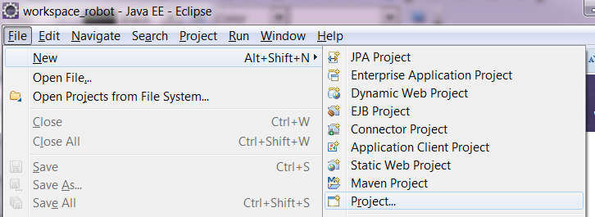
Hello World
Traditional first program
File > New > Project

Slide 5
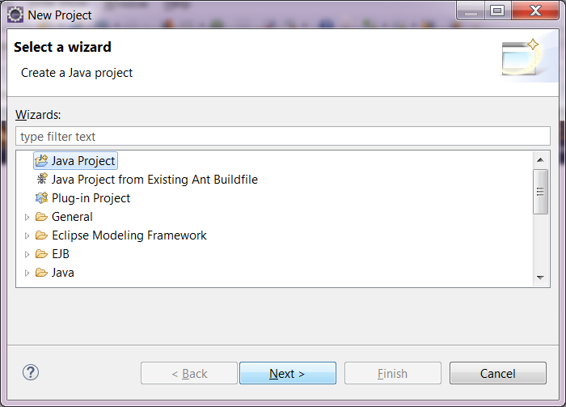
Hello World – Create Project
Java Project, Next

Slide 6
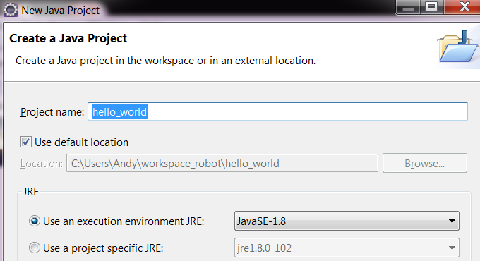
Hello World – Create Project
Project name “hello_world”, Finish
TIP: good idea to use “_” rather than a space when programming. A space let the computer know you have finished something, so don't use it unless that's what you want

Slide 7
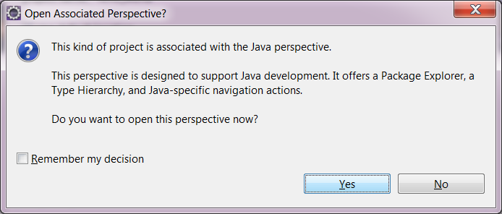
Hello World – Create Project
Yes

Slide 8
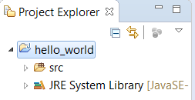
Hello World – Create Project
We just created a Java “Project”
A project is a group of Java classes that work together to achieve a program's goal (or part of the goal)
  A calculator
  A controller for a robot

Slide 9
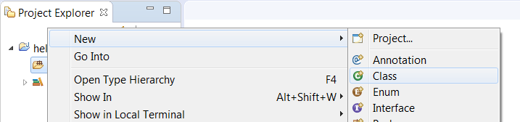
Hello World – Create a class
Right click “src” and then new > class

Slide 10
Hello World – Create a class
A class is a Java file that contains program code
A Java project is made up of 1 or more classes that work together
Generally each “object” in the program will be in its own class
A programmer can instantiate a class to create a instance of it to use in their program

Slide 11
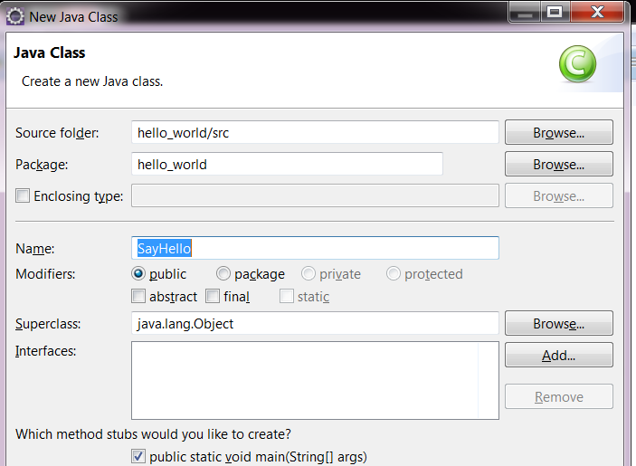
Hello World – Create a class
Name: SayHello
Check: public static void main(...)

Slide 12
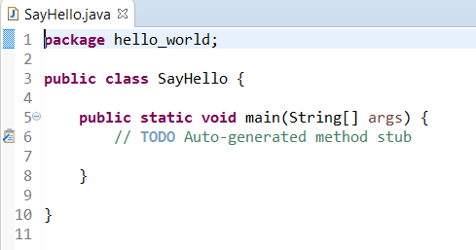
Hello World – SayHello.java

Slide 13
Hello World - Package
Package: A group of related classes. Like a “cars” package that may contain the classes:
  Ford, Audi, BMW, Honda, ...
When someone is looking to create a Toyota the “cars” package would be a good place to look

Slide 14
Hello World - Class
Class: The object that the code inside the file relates to. Almost anything could be a class if it makes sense.
  We could have a “calculator” class that performed math operations
  If our calculator was complex we may split down further and have “button”, “display”, “power”, etc. classes

Slide 15
Hello World - Method
Method: Some functionality that we want grouped together within our class so that we can “call” it. In a calculator we may want to call “add”, “subtract”, “multiple”, etc.
Arguments: Data that we can pass to a method, such as add( 1, 5 )

Slide 16
Hello World – Return Type
Return Type: What does our method return? Currently nothing. A calculator “add” method would probably return a number, like:
  public int add ( int x, int y )
  It takes the arguments x and y and returns another integer which is x and y added together

Slide 17
Hello World - Visibility
Visibility: Who can call this method? If we have a method “delete_all_files()” then perhaps we don't want to allow everyone access to it.
Our method is “public” so everyone can current call it

Slide 18
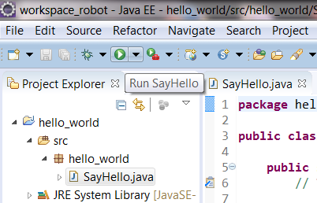
Hello World – Run it
Click on HelloWorld.java
Click the “Run” button

Slide 19
Hello World – What happened
Our program ran
It did exactly what we've told it to do – nothing
Eclipse called javac to compile our HelloWorld.java to HelloWorld.class (bytecode) and then ran it

Slide 20
Hello World – Objects
Java is an OBJECT ORIENTED language
We organize our code based on unit that make sense to place together as an Object
For example, we may have a Car object
  It may have a Tire Object
  A door Object
  A seat Object
The objects will have properties such as color, pressure, etc.

Slide 21
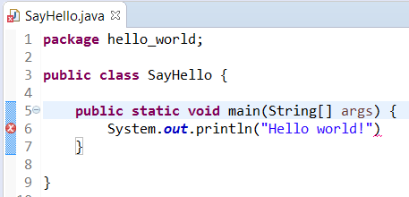
Hello World – Say Hello
Use the System object to output text to the computer system
System.out.println("Hello world!")

Slide 22
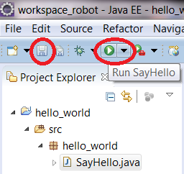
Hello World – Save and Run
Click “Save”
Click “Run”

Slide 23
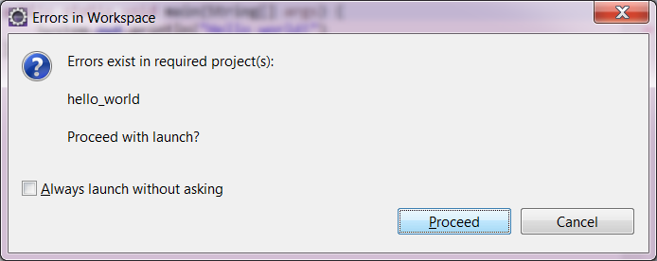
Hello World – Save and Run
Click “Proceed”

Slide 24
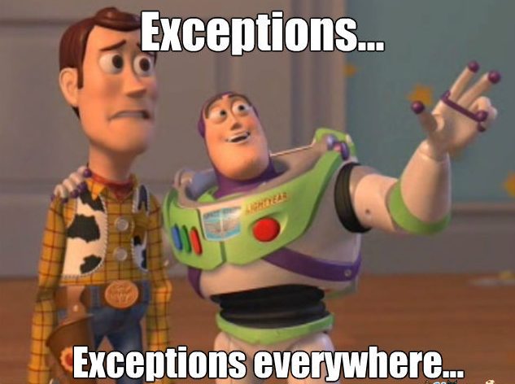
Hello World – Oh no!

Slide 25
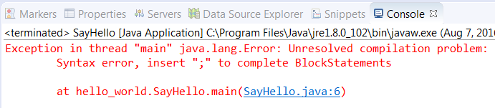
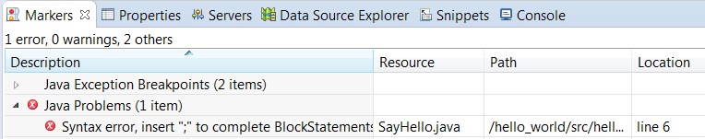
Hello World – IDE help
The console will show us the problem
Also, click “Markers”

Slide 26


Hello World - ;-)
; tells Java that you have finished a command. Other space is just “white space”

Slide 27
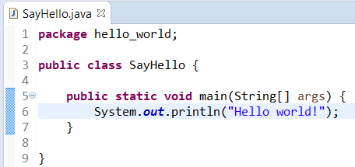
Hello World – Fixing it
System.out.println("Hello world!");

Slide 28
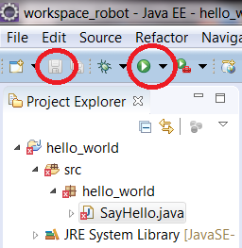
Hello World – Save and Run
Click “Save”
Click “Run”

Slide 29

Hello World – Hello!
Look at the console at the bottom of the screen

Slide 30
Hello World – What happened?
We used the “System” object to interact with out compute system
We used the “out” object as we wanted to output to the system
By default the System.out directs output towards our programming console
We used “out”'s println() method to print a line of text

Slide 31



Debugging
If we run the program we get the result

Slide 32


Debugging
We can double click at the left edge of a line to pause the execution of the program

Slide 33
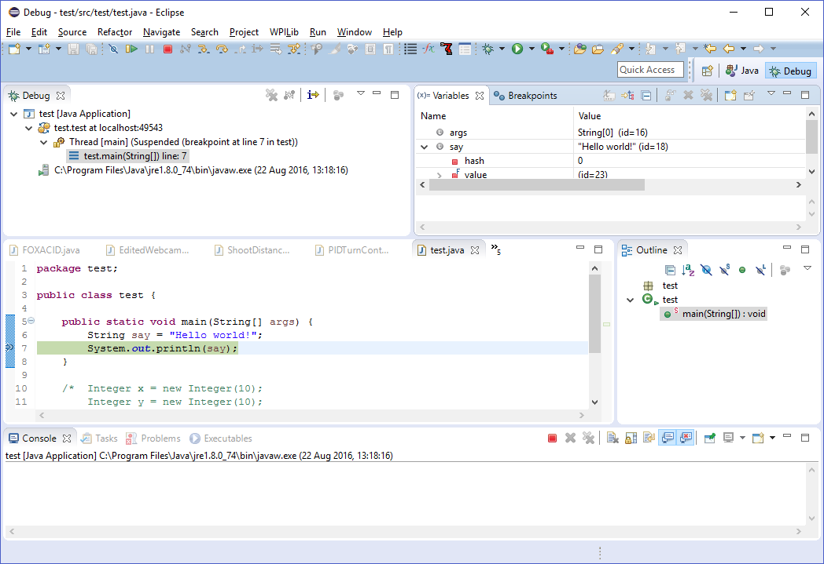
Debugging

Slide 34
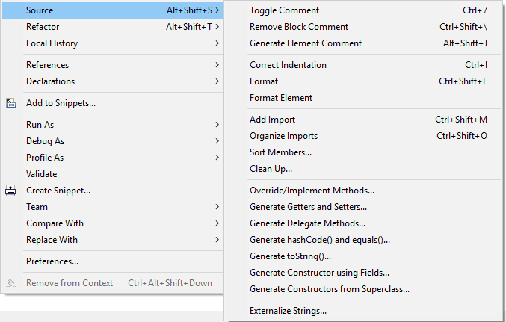
Generate Code
We can get Eclipse to generate code for us

Slide 35
Hello World - Overview
We make our first Java class
We interacted with the System object
We fixed an Exception
We ran our program
You're now officially a Java programmer

Slide 36

How to become a good programmer
Just do it
  I started by cheating at computer games
THINK BEFORE you type
  Less is more in programming
Solve the problem first, don't just use the language
  Learn pseudocode - the best programming language
Use Stack Overflow, it's the programmer's version of a dictionary
Divide and conquer
  Always the best approach (...most of the time)
  If you can't solve a problem, make it two smaller ones, then four...
  The best go-to answer in interviews
Zero is the first number: 0, 1, 2, 3, …
Never listen to Evan or Rob

